Slide 1
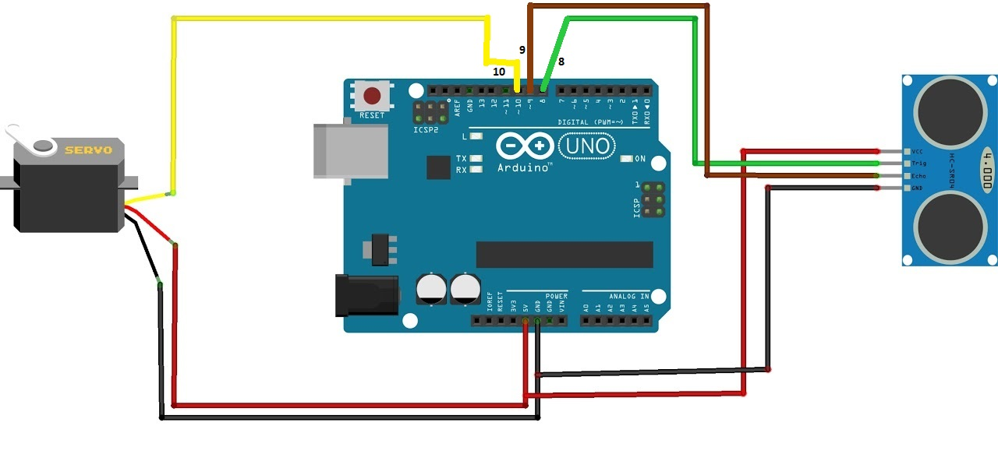
Arduino Ultrasonic RADAR Project

